Slide 1
Project DELFT Digitizing Ethnological Films - an Expedition from Analogue to Digital
Miriam Reiche
No Time to Wait Conference, October 25-26, 2018

Slide 2
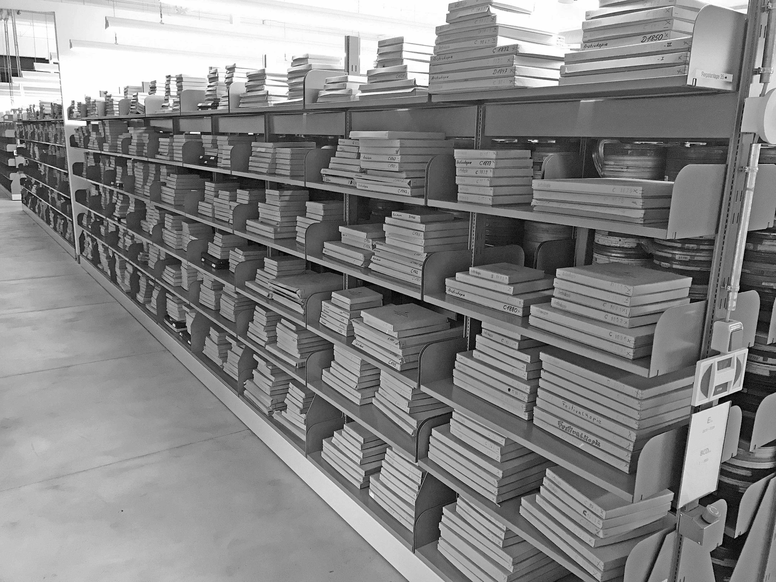
DELFT: The Film Collection Institut for Scientific Film IWF
11.500 film titles
33.000 film copies
One of the world‘s largest collections of scientific films

Slide 3
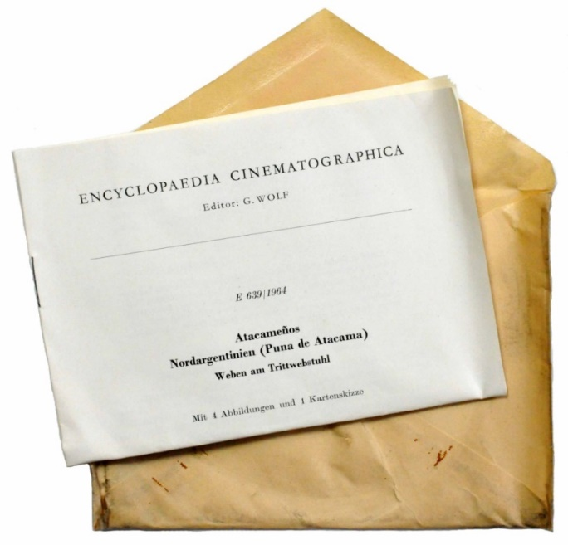
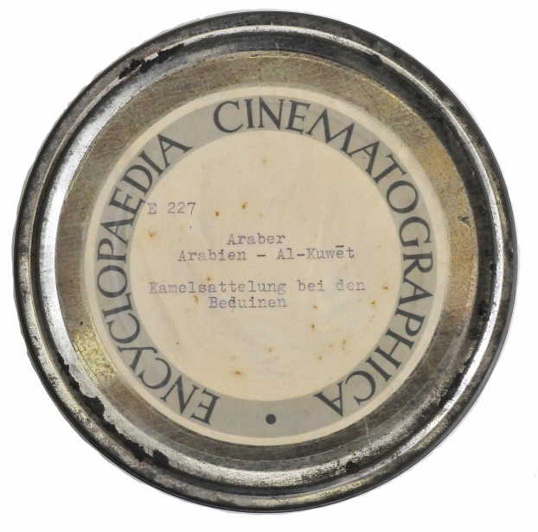
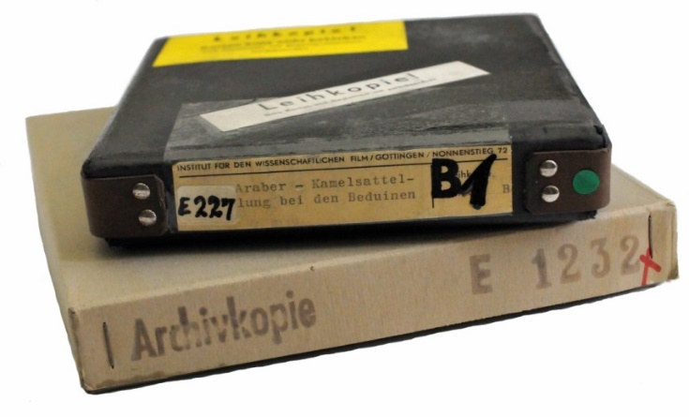
DELFT: The Ethnological Films of the Encyclopaedia Cinematographica
Founded in 1952 by Gotthard Wolf
Natural Sciences, Technology, Life Science, Medicine, Cultural Studies, Psychology

Slide 4
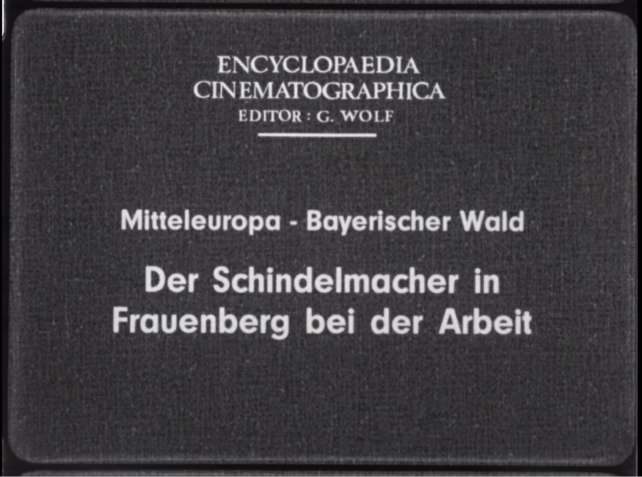
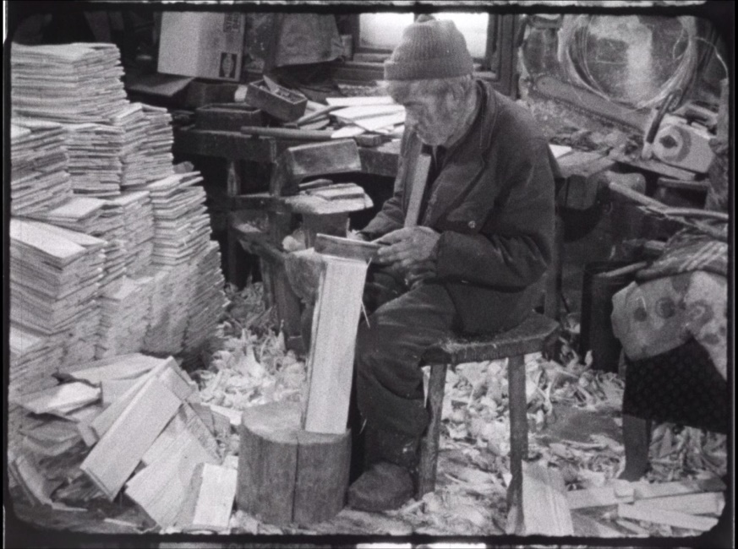
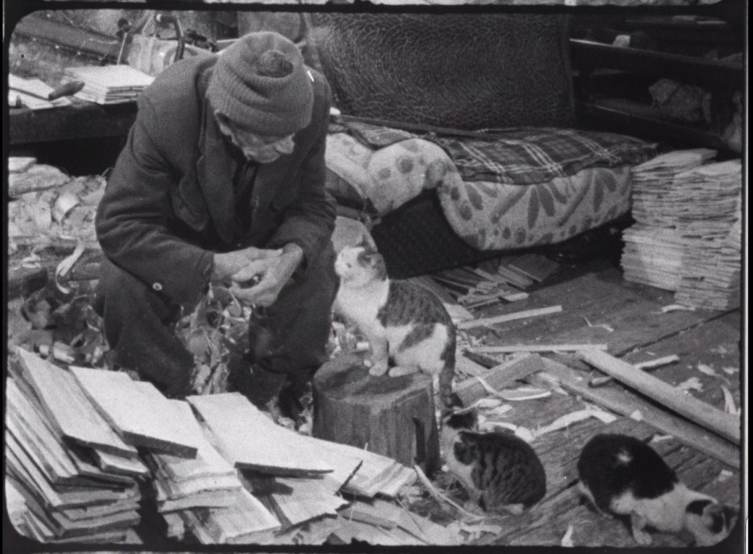
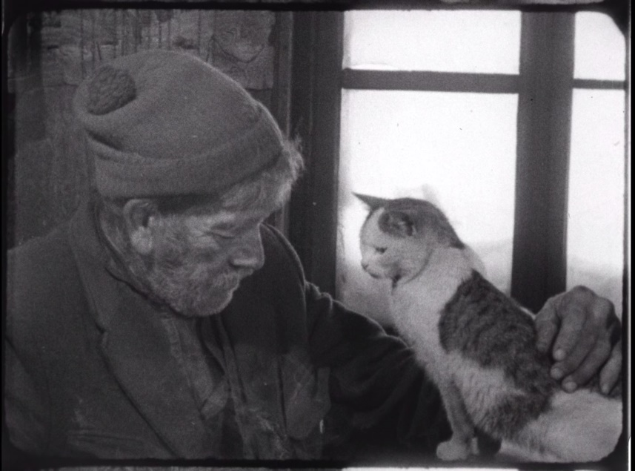
DELFT: The Ethnological Films of the Encyclopaedia Cinematographica

Slide 5
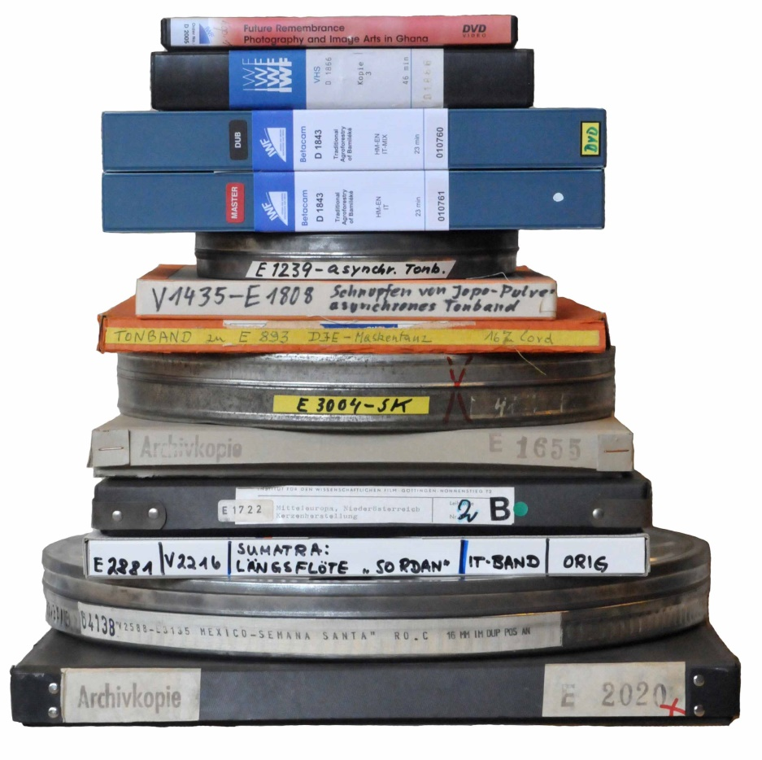
DELFT: Film Stock
16mm Film copies (film base celluloseacetat, safetyfilm)
black and white, colour
silent films
films with optical tracks
SEPMAG, magnetic tape
asynchronous audiotapes
Digital Betacam
additional material

Slide 6
DELFT: Project Goals
Project Duration: October 2017-September 2019
Digitization of ca. 2000 film titles, approx. 500 hours of film
Cataloguing of the films
Making the films available via TIB‘s AV-Portal
Clarification of legal rights
Digital Object Identifier DOI for each film
Digital preservation

Slide 7
DELFT: Process
Step 1: Selection of the film copy
Step 2: Choosing target format
Step 3: Digitizing
Step 4: Quality control
Step 5: Digital preservation

Slide 8
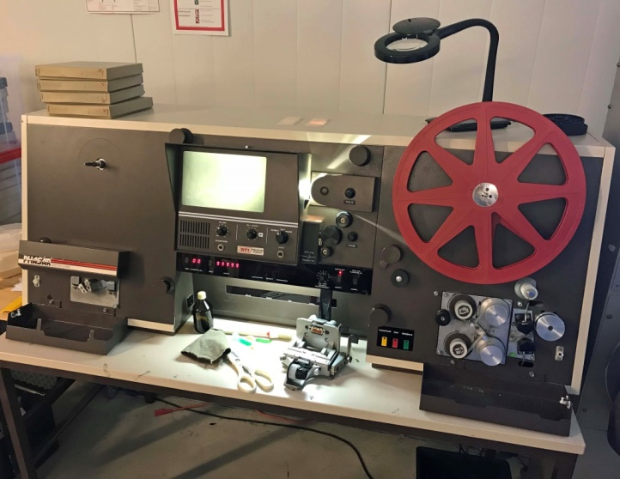
Step 1: Film Copy Selection
Each digitizing project starts with the selection and description of the analogue object!
Filminspector RTI Pulsar
Selection of the film copy
Recording data for each film:
Copy
Mechanical damage
Vinegar
Shrinkage
Colorfading

Slide 9
Step 2: Target Formats 16mm Film
Original Format:
16mm Films positive black/white or color
Resolution: 2K
Sampling rate 10 bit
Color model and subsampling RGB 4:4:4
Frame rate: comparable to the original (16/18/24FPS)
Overscan
Target Format
Container: Matroska (.mkv)
VideoCodec: ffv1, Version 3 (GOP of 1, 16 Slices, CRC-Checksums per Slice)
Audio-Codec: linear PCM 96 kHz / 24 bit
Derivative Copy
Container: MPEG-4
Video Codec: H.264, CRF 20
Compression to 65%
original scanning resolution without scaling
4:3 aspect ratio
Audio Codec: AAC

Slide 10
Step 2: Target Formats Digital Betacam
Original format: Digital Betacam black/white or color
Resolution: 720 x 576 Pixel
Framerate comparable to the original
Quantization/Bit: 10 bit
Color Space: Y′CBCR
Subsampling: 4:2:2
Master Interlaced
Derivative Progressive

Slide 11
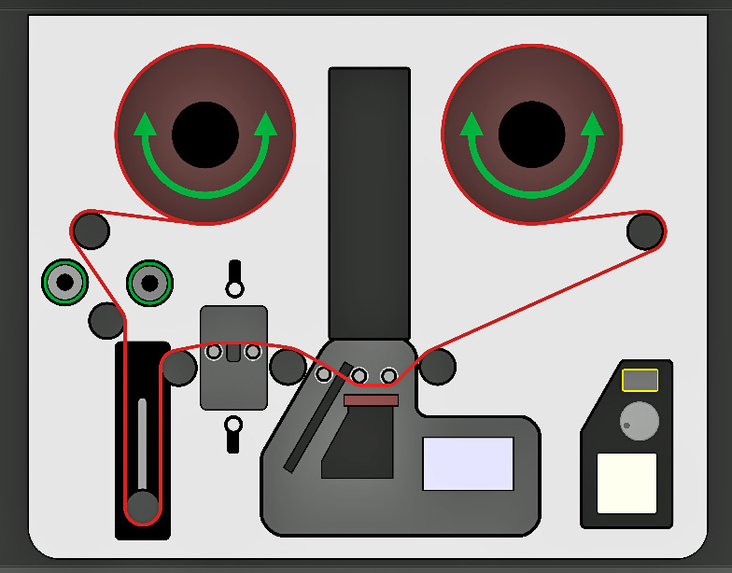
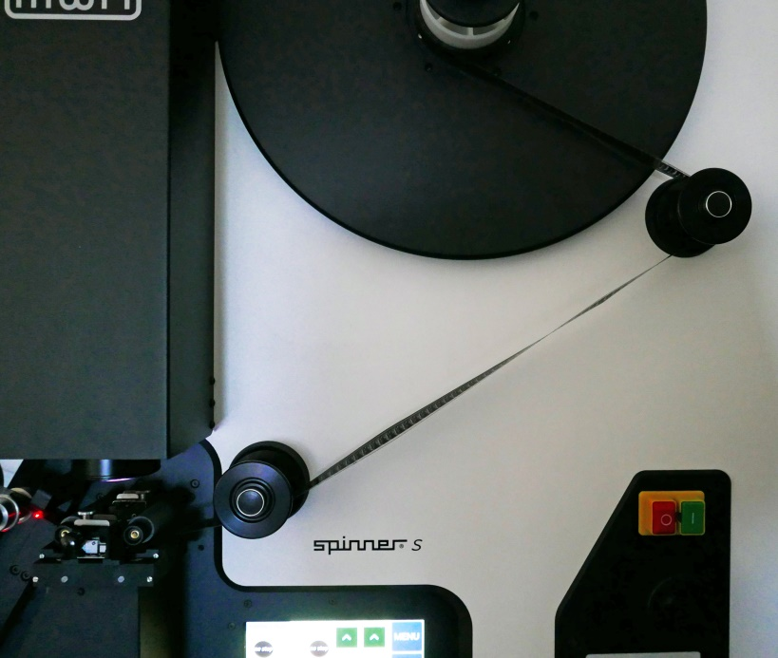
Step 3: Digitizing
Scanner: MWA Nova Spinner S
sprocketless and capstanless motion transport
unlimited shrinkage, warped film
large rollers for reduced stress on splices or brittle film
stable filmtransport
Warped film in the scanner

Slide 12
Step 3: Digitizing
The scanner's diffuse light source reduces the effects of mechanical damage such as scratches etc.

Slide 13
Step 4: Quality Control
→ 7 hours Film per Week → 2TB SSD Harddrive
Archival master ffv1/mkv
Derivative copy H.264/mp4 and H.265/mp4
Checksums framemd5
Technical metadata
Correct name of the file
Content completeness: film title, film duration
Image quality (artifacts etc.)
Playability of the master
File format validation
Policy alignment
Checksum check

Slide 14
Step 5 Digital Preservation
AV Material in the Digital Archive
Collection: Projectnumber xyz (x films)
Preservation Master: | ffv1/mkv
Metadata:
Derivative Copy: | H265/mp4
Metadata:
Derivative Copy:
Preservation Master: | ffv1/mkv
Metadata: | descri
 | conservation MD (analogue film copy)
Derivative Copy: | H265/mp4
Preservation Master:
Metadata:
Derivative Copy:
SIP Digitized Film
Preservation Master: | ffv1/mkv
Metadata: | descriptive MD
 | technical MD
 | conservation MD (analogue film copy)
Derivative Copy: | H265/mp4
SIP MAM Material
Preservation Master: | H264/mp4
 | supplementary material (booklet)
Metadata: | descriptive MD
Derivative Copy: | AdvancedVideo Codec/mp4 (for download)
SIP Project xyz Material
Preservation Master: | Project files photos descriptions etc.
SIP = Submission Information Package

Slide 15
DELFT Experiences: Quality …an example: Digitizing 2007
Source material: 16mm - but which copy?
Resolution: SD and HD - but which film in which resolution?
Retouching, color correction - no documentation!
→ The digitization took place 20 years ago and we already have loss of information!

Slide 16
DELFT Experiences: Definition of quality
Sustainability in the choice of digitization parameters
Collecting of standardized metadata
Documentation of the source material
Preservation of the originals
Retaining the authenticity of the original material

Slide 17
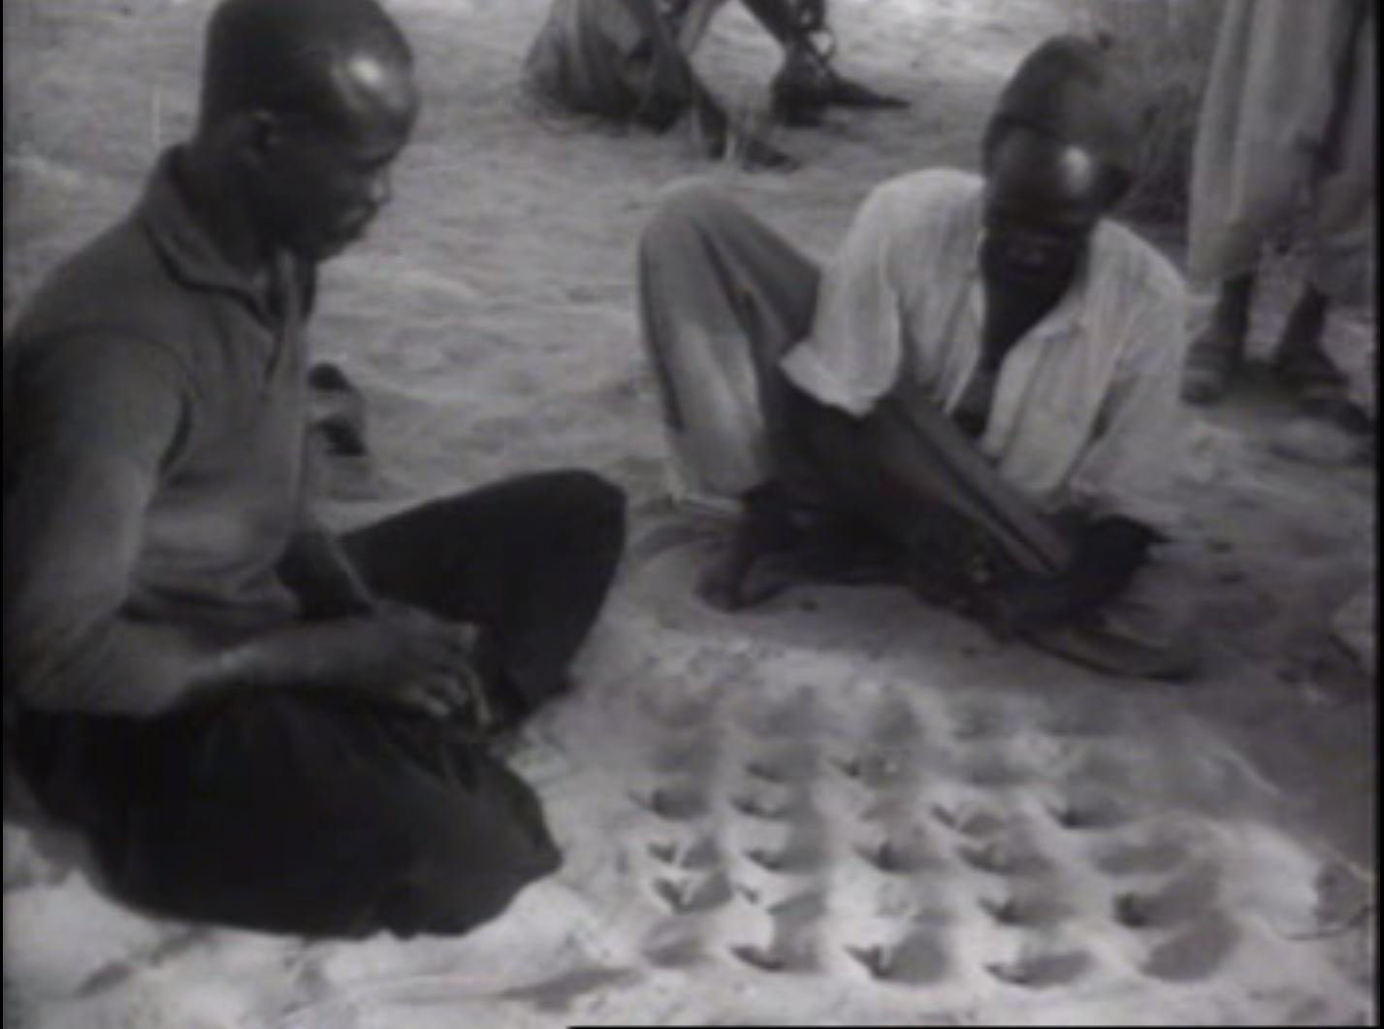
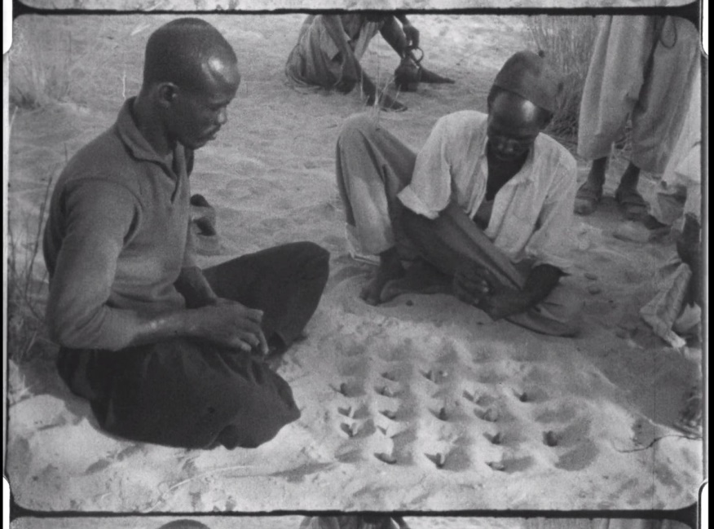
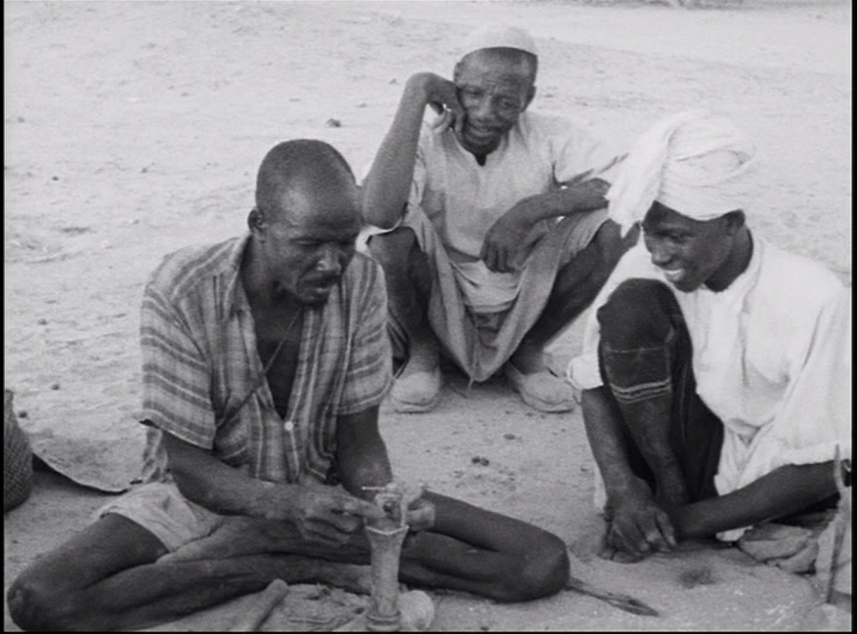
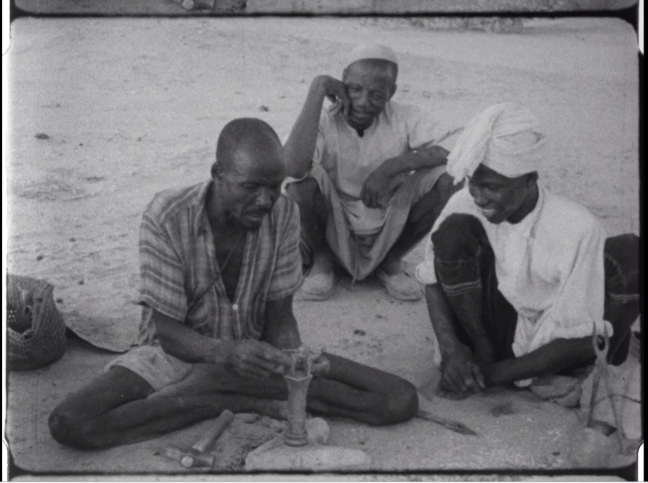
DELFT Experiences: Retaining the authenticity of the original
mpeg1 (2007)
mp4 (2018)
vob (2007)
mp4 (2018)

Slide 18
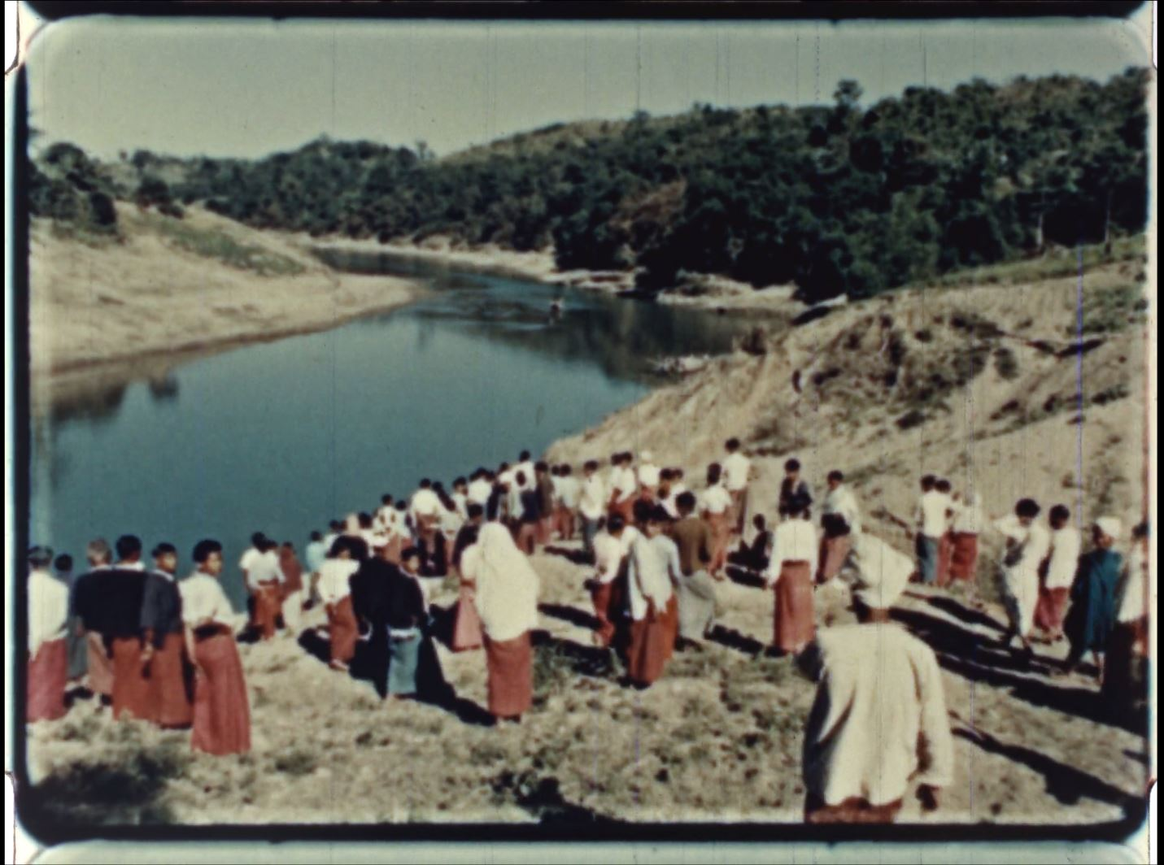
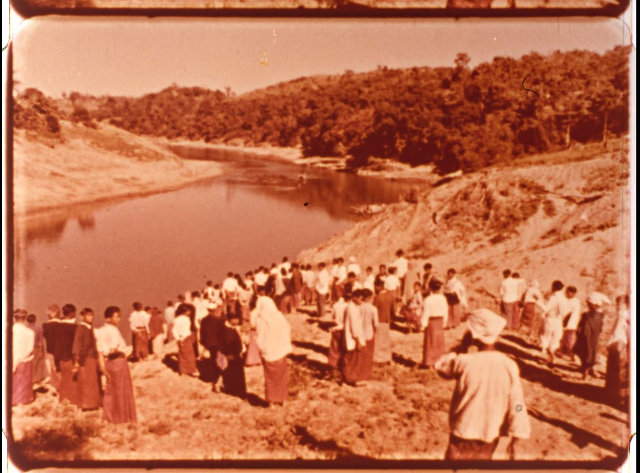
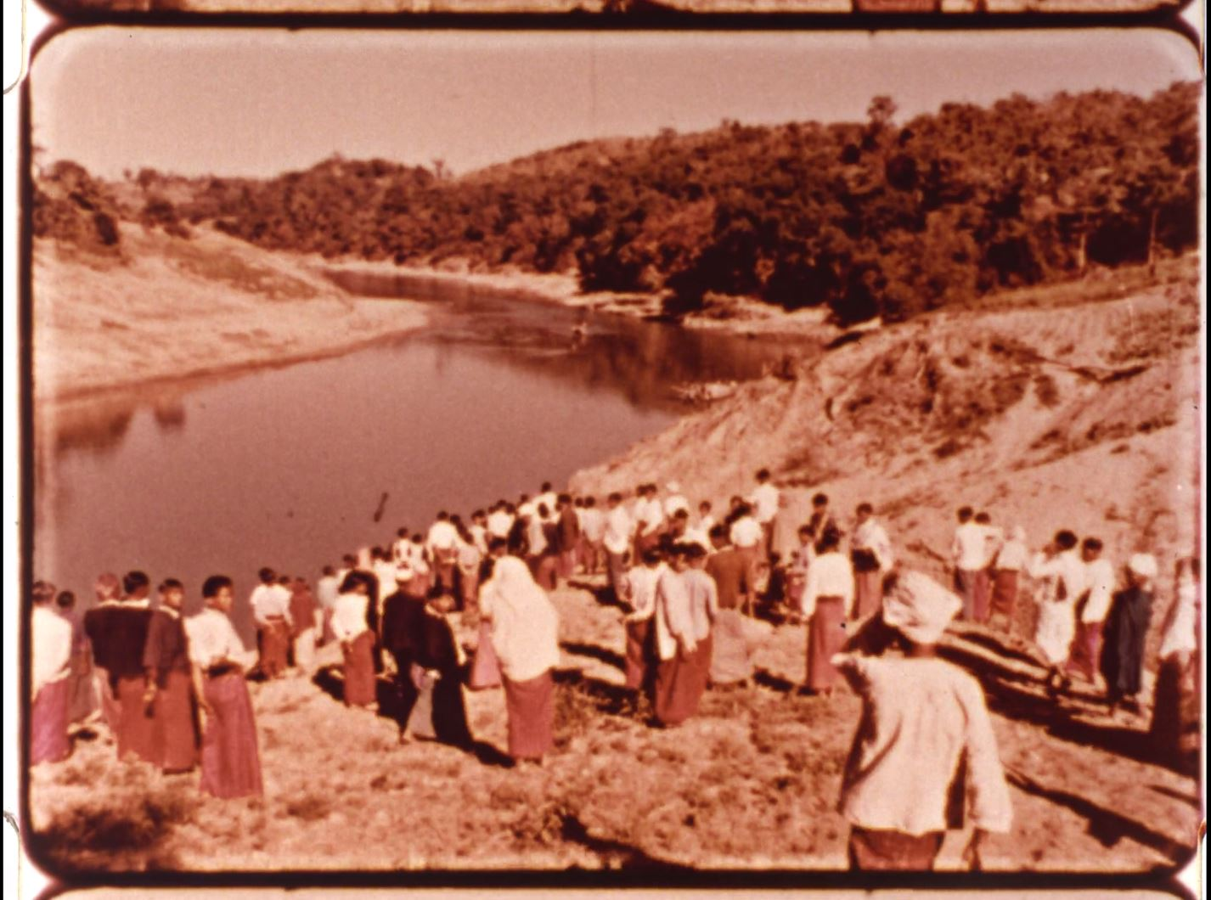
DELFT Experiences
Know your stuff !
The potential of a digital representation lies in the materiality of the analogue object; the technical possibilities help to transfer this potential.
Distribution copy 1
Archival copy
Distribution copy 2

Slide 19
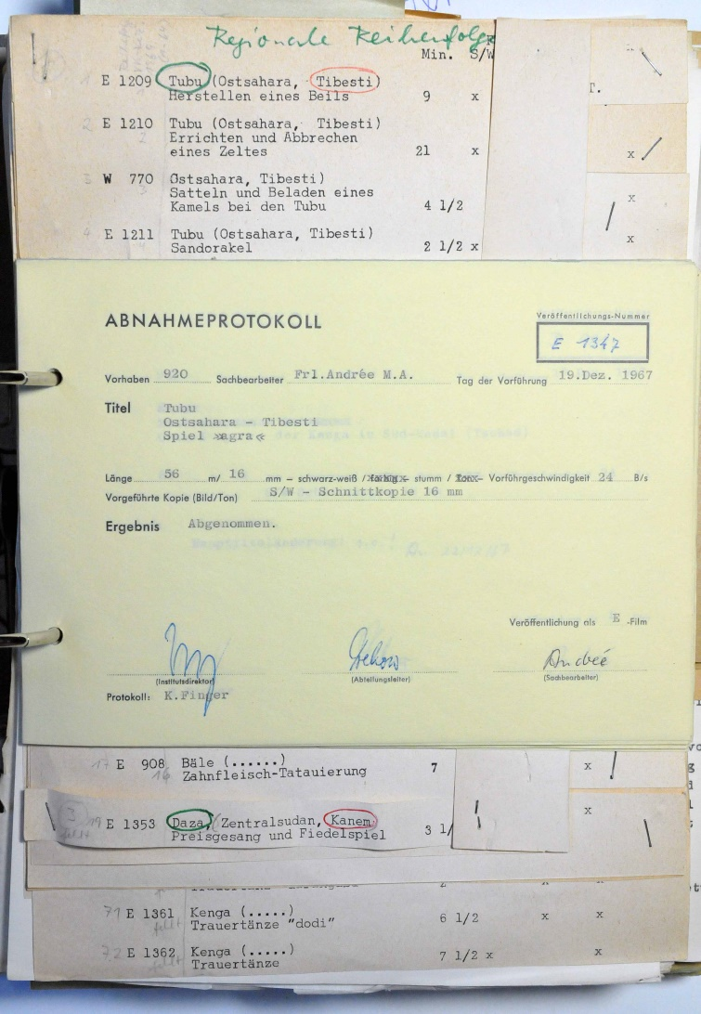
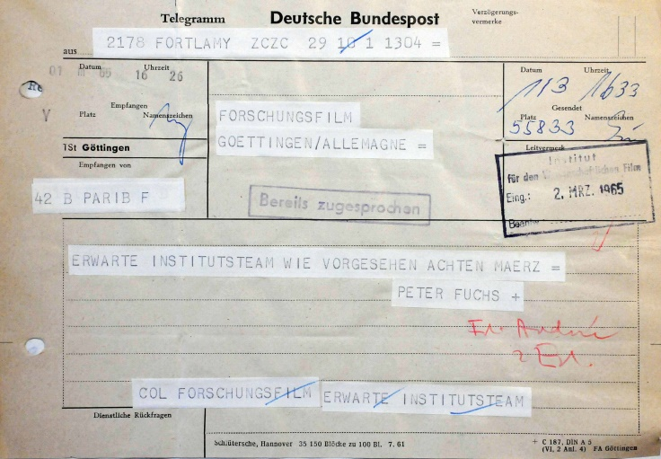
DELFT Experiences
Additional materials contextualize the film!

Slide 20
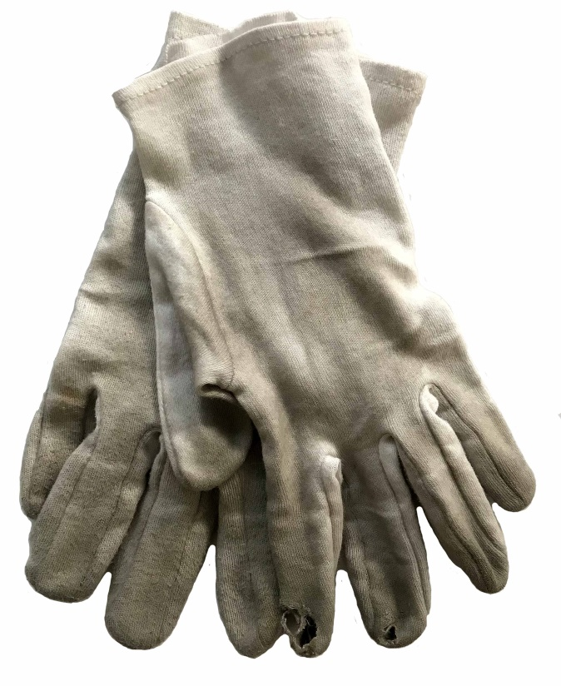
MORE INFORMATION: www.tib.eu TIB Digital Preservation: https://www.tib.eu/de/publizieren-archivieren/digitale-langzeitarchivierung/ Project DELFT: https://projects.tib.eu/delft/
Contact
Miriam Reiche
T +49 511 762-2587, Miriam.Reiche@tib.eu

