Slide 1
Tech 2026
15-19 JUNE

Slide 2
FRAME Advanced Tech 2026
The Open Source Ecosystem
Made by Archivists

Slide 3
What is MediaArea
Open source software company focused on digital media analysis.
Not a single entity, but a group of independent developers.
2026

Slide 4
2026
Why QC is important?
1
Why open source?
2
MediaInfo
3
MediaConch
4
5
QCTools and more

Slide 5
2026
Why quality control is important?

Slide 6
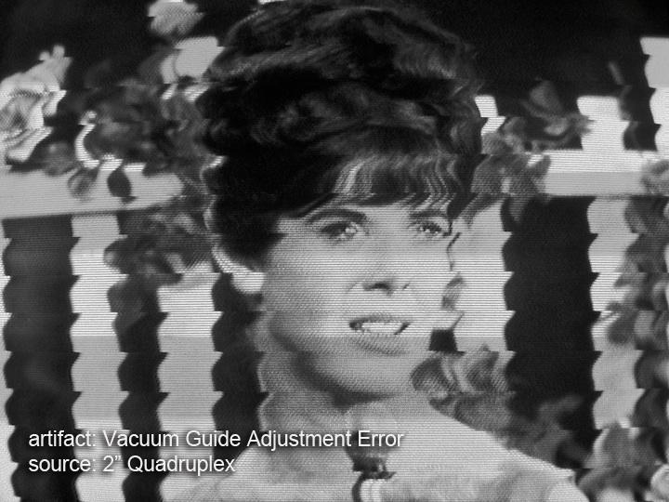
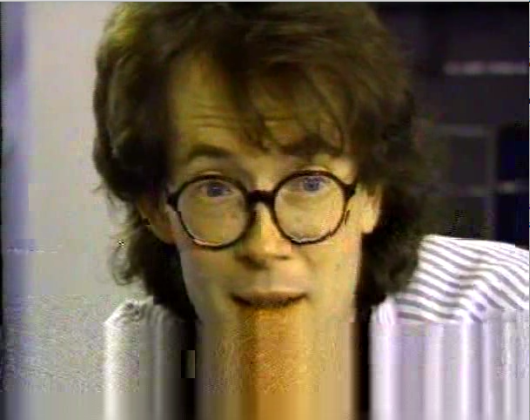
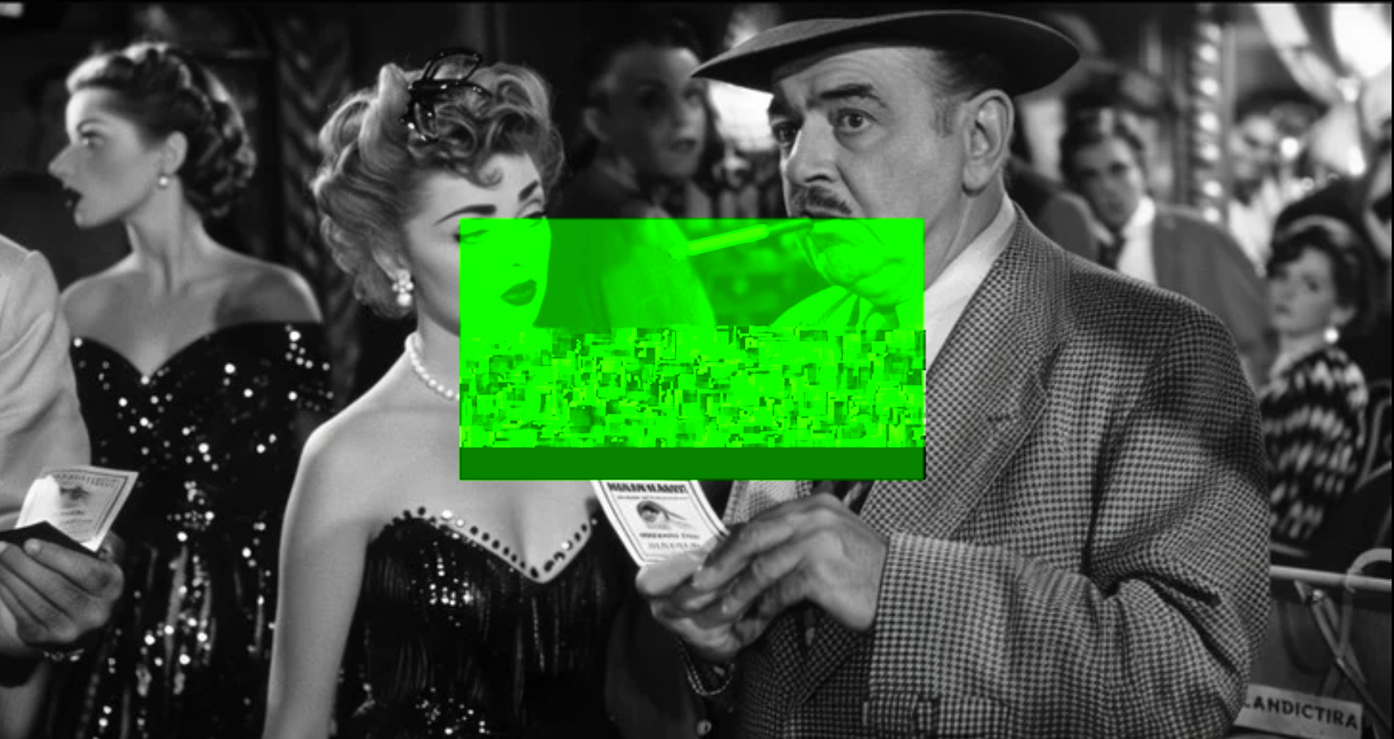
Why quality control is important?
If you don’t handle that now,
content is definitely partially lost.
2026

Slide 7
Why quality control is important?
Your digital copy provider is available now
In the future, your content provider may have disappeared, trashed content…
The original tape is still there, but for how long?
The original tape is still there, but for how long?
Or your tape becomes no more readable.
2026

Slide 8
Why quality control is important?
Easier to catch quality issues and fix them now than later.
When someone else discovers quality issues, it may be too late.
2026

Slide 9
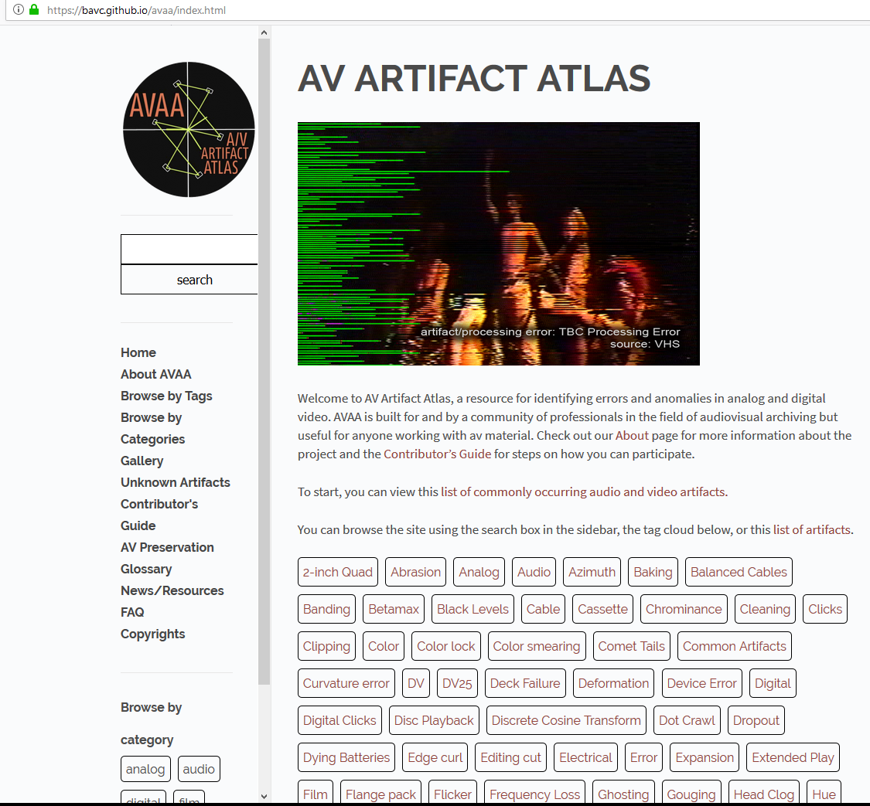
Why quality control is important?
You are not alone
Example of online support:
AV Artifact Atlas, a resource for identifying errors and anomalies in analog and digital video. AVAA is built for and by a community of professionals in the field of audiovisual archiving but useful for anyone working with AVmaterial.
https://www.avartifactatlas.com
2026

Slide 10
Why quality control is important?
You are not alone
Organization of symposiums has a cost.
- Hosting granted by a main sponsor
- Other archives or vendors may provide additional financial support
“No Time To Wait” 2026 will be at Filmoteka Narodowa – Instytut Audiowizualny (FINA)" in Warsaw on October 14-16.
Current main additional sponsor is Centre national de l’audiovisuel Luxembourg (CNA)
https://mediaarea.net/nttw10
Example of symposiums:
“No Time To Wait” symposiums are free events focused on open media, open standards, and digital audiovisual preservation.
Symposium program is made by archivists, who present how they work and the associated (open source) tools.
Past events:
https://www.youtube.com/@MediaAreaNet
2026

Slide 11
2026
Why open source?

Slide 12
Why open source?
The archival domain
Relatively small market (niche)
Off-the-shelf products often focus on different use cases
Highly specialized demands
High potential for vendor dependence...
2026

Slide 13
Why open source?
Why not Proprietary tools ?
Proprietary tools and formats are linked to one, and only one, vendor
If vendor disappears, it is impossible to get bug fixes
Without source code, you can not adapt yourself to new platforms: are you sure you’ll be able to run the software in 100 years?
Vendor decides on the new features
Are you big enough for making the vendor develop your preferred feature?
2026

Slide 14
Why open source?
The four freedoms of open source
Proprietary tools and formats are linked to one, and only one, vendor
- The freedom to run the program as you wish, for any purpose
- The freedom to study how the program works, and change it so it does your computing as you wish
- The freedom to redistribute copies
- The freedom to distribute copies of your modified versions to others
2026

Slide 15
Why open source?
Reusability
Everyone can use everything
An example
FFmpeg: A complete, cross-platform solution to record, convert and analyze audio and video.
Adapted and reused in several MediaArea’s open source tools
Sometimes tweaked
2026

Slide 16
Why open source?
Open source does not mean not professional
Support contracts
Paid installation/integration
Hire developers
2026

Slide 17
Why open source?
A real-world example
The lossless video codec FFV1
Austrian National Archive (Mediathek) wanted to do lossless digital video archiving
Not satisfied with existing products (Interoperability issues)
Found FFV1 in FFmpeg: Excellent codec, but we wanted/needed more...
Contacted and hired a FFV1 developer
Other parties involved for advices (pooled resources)
Budget calculated in reference to costs of proprietary alternatives
Now FFV1 version 3: faster and integrity-aware
So: other archives use FFV1, for free!
2026

Slide 18
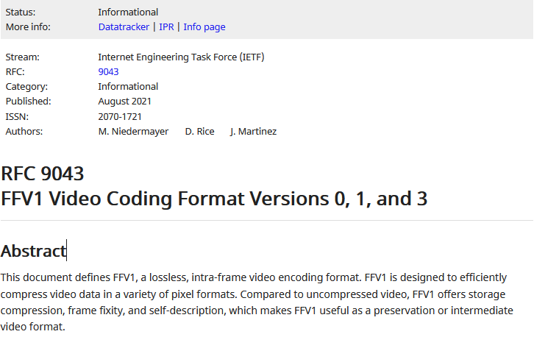
Why open source?
A real-world example
FFV1 version 3 is now a standard
FFV1 version 4 in progress:
float numbers, Bayer/RGGB…
2026

Slide 19
Why open source?
Quality of tools
Chicken and egg: if everyone waits, nothing happens
We start with needs easy to handle and we create dedicated open source tools
Tools become bigger, step by step, when more people join
YOU can decide about participating in lowering the overall cost for archives.
2026

Slide 20
Why open source?
Funding
Driven by user requests
Most of tools were funded after a need is detected by users
Why paying for something you don't control? (is your current choice future proof?)
Everyone (you included) can develop or sponsor a development
You can fork if you think you have a better idea than others
2026

Slide 21
2026
MediaInfo

Slide 22

MediaInfo
A technical information reporter
Convenient unified display of the most relevant technical and tag data for video and audio files.
2026

Slide 23
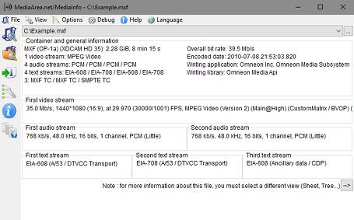
MediaInfo
A technical information reporter
Output: text, XML, HTML, PBCore, EBUCore…
Container: format, profile, commercial name of the format, duration, overall bit rate, writing application and library, title, author, director, album, track number, date, duration...
Video: format, codec id, aspect, frame rate, bitrate, color space, chroma subsampling, bit depth, scan type, scan order...
Audio: format, codec id, sample rate, channels, bit depth, language, bit rate...
Text: format, codec id, language of subtitle...
Chapters: count of chapters, list of chapters...
2026

Slide 24
2026
MediaConch

Slide 25

MediaConch
A conformance checker
Implementation checker
Policy checker
Reporter
2026

Slide 26


MediaConch
Funding
Initial development sponsored by European Union (PREFORMA project)
Focused on FFV1 and Matroska.
We added formats supported by MediaInfo to the policy checker.
2026

Slide 27
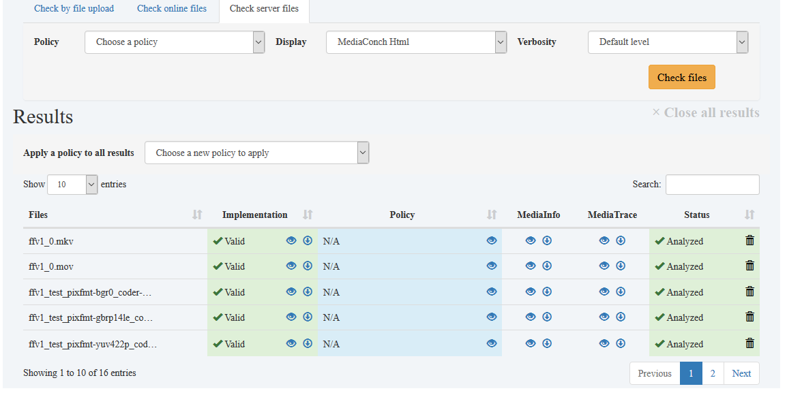
MediaConch
Implementation and Policy reporter
2026

Slide 28
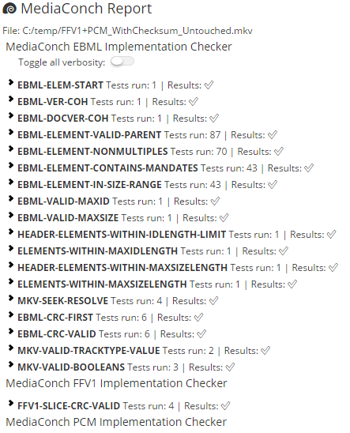
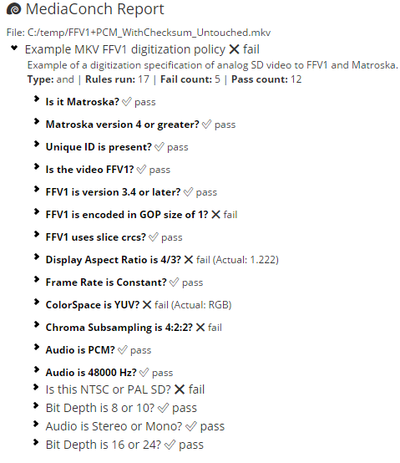
MediaConch
Implementation and Policy reporter
Compared to a specification or compared to your policy
2026

Slide 29
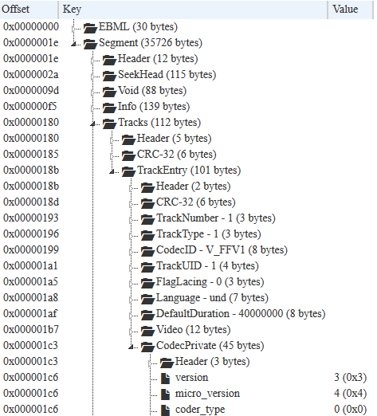
MediaConch
File inspection
2026

Slide 30
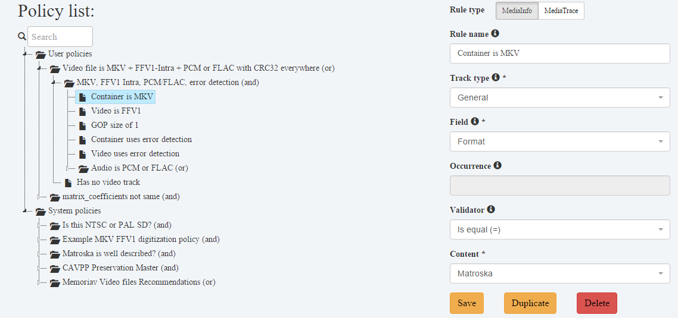
MediaConch
Policy editor
2026

Slide 31
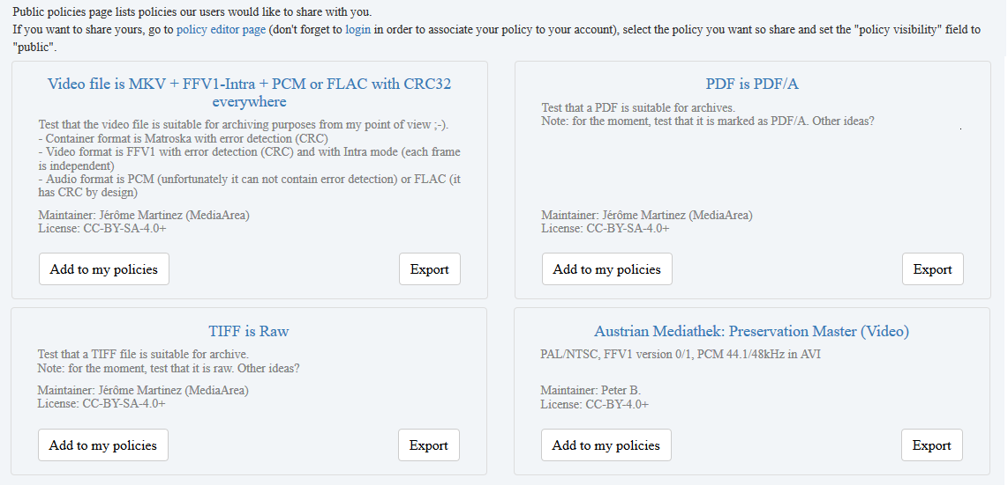
MediaConch
You are not alone
2026

Slide 32
2026
QCTools

Slide 33

QCTools
Helps users analyze and understand their digitized video files
through use of audiovisual analytics and filtering.
2026

Slide 34
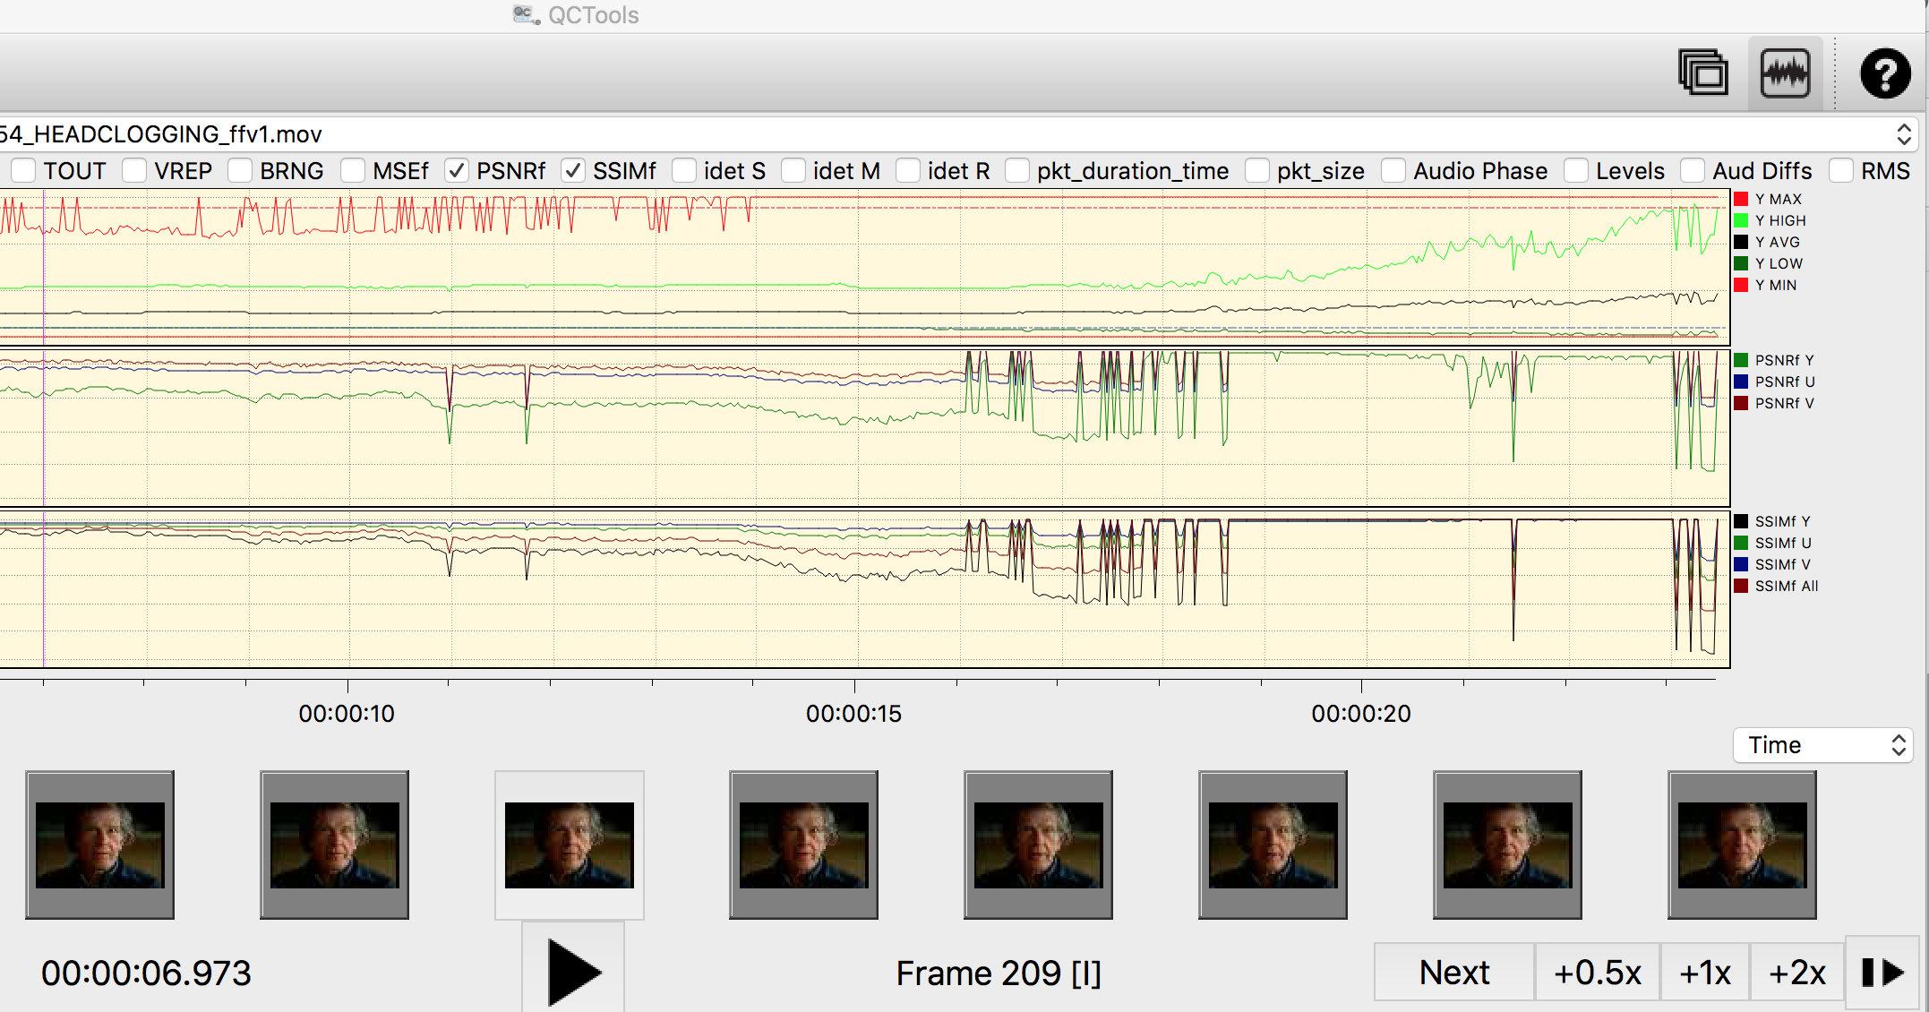
QCTools
2026

Slide 35
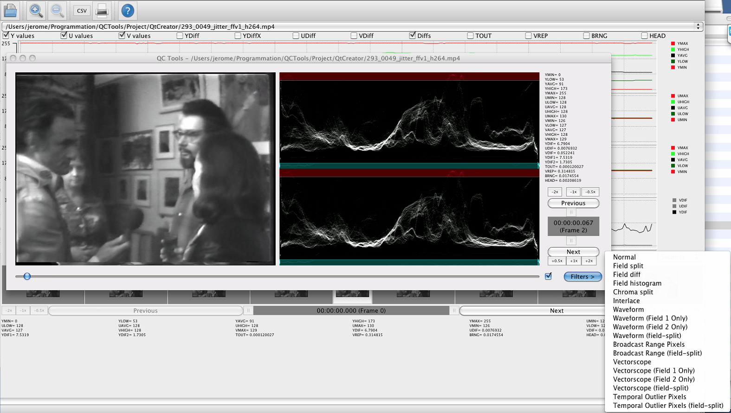
QCTools
2026

Slide 36
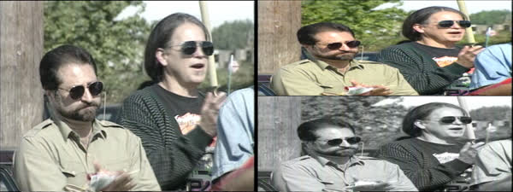
QCTools
2026

Slide 37
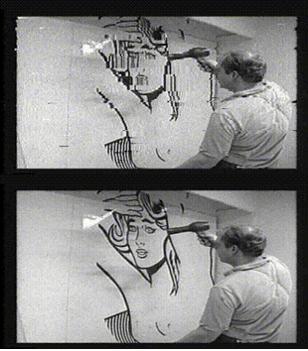
QCTools
2026

Slide 38
2026
RAWcooked

Slide 39
RAWcooked
The issue
1 DPX/TIFF file per video frame
Not playable as is by several players (VLC...)
Huge size
So many DPX or TIFF format flavors
(interoperability issues)
And need of keeping all metadata
2026

Slide 40
RAWcooked
The goal
1 file with all (video, audio, sidecar files)
Playable by a lot of players (MKV+FFV1+FLAC)
Size divided by 2
Reversible to source format if needed
Easy to use
2026

Slide 41
RAWcooked
The solution
Easy: just a short command line
"rawcooked YourDirectoryName“
Store DPX/TIFF headers/footers in a specific Matroska attachment
Store other sidecar files as Matroksa attachments
Output is a single Matroska/FFV1/FLAC file
Encoding is reversible (bit-by-bit to original files)
"rawcooked YourMatroskaFileName.mkv"
2026

Slide 42

RAWcooked
Long term sustainability
~50 RAWcooked sponsors
A niche market
No big company interested
The initial effort was not small
Each single entity needing that can not afford a full development
We needed to find a different development model
And more
2026

Slide 43
RAWcooked
Long term sustainability
~50 RAWcooked sponsors
A different business model based on license key
We provide a key for other format flavors and features (temporary key possible)
1000 € for first flavor/feature
+ 500 € per additional flavor/feature
Except for GPU support (1000 €)
To be compared with storage cost saving
(storage cost divided by 2)
And more
2026

Slide 44
2026
BWF MetaEdit

Slide 45
BWF MetaEdit
Metadata edition
Library of Congress (USA) centralized the management.
Edition of WAV/BWF metadata for conforming to ther guidelines.
https://www.digitizationguidelines.gov/guidelines/digitize-embedding.html
2026

Slide 46
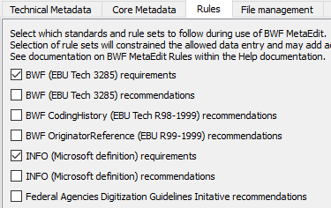
BWF MetaEdit
Metadata edition
2026

Slide 47
BWF MetaEdit
Open source! And versatile
Other entities needed metadata edition for other formats.
AVI MetaEdit and MOV MetaEdit are born.
Forks of BWF MetaEdit, same idea, same core source code.
Cheaper!
2026

Slide 48
2026
DVRescue

Slide 49

DVRescue
Improve DV dumps
DV format is complicated.
Lot of different vendors with specific issues.
National Endowment for the Humanities centralized the management.
Need to make capture easier
2026

Slide 50
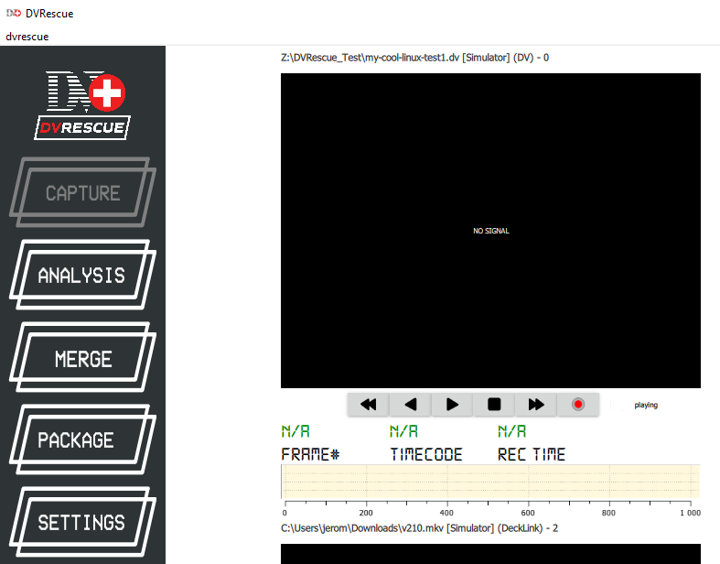
DVRescue
Improve DV dumps
2026

Slide 51
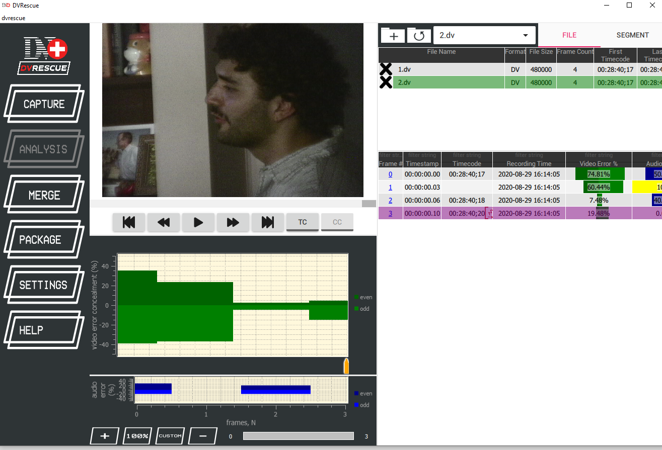
DVRescue
Improve analyze
2026

Slide 52
DVRescue
Optimize DV dumps
Now a tool for dumping DV from tape several times and peek the best dump.
Not by file… Not by frame… By macroblock.
2026

Slide 53
2026
mkvnote

Slide 54
mkvnote
The issue to resolve
MKV is a container format.
Lot of tools for editing MKV metadata.
But… Command line ☹.
Not everyone is able to use it.
2026

Slide 55
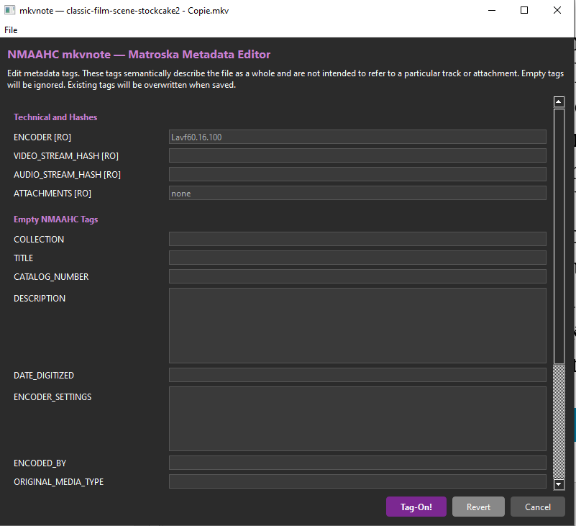
mkvnote
The solution
2026

Slide 56
mkvnote
A graphical interface easy to use
Smithsonian National Museum of African American History and Culture (NMAAHC)
needed something easier to manage.
And adapted to their needs.
We develop a dedicated tool for the graphical interface,
using existing open source command line tools.
Not so expensive.
2026

Slide 57
2026
LeaveSD

Slide 58
LeaveSD
How to leave a proprietary format
STARDIVA® storage format based on NSV but with opaque metadata format and 8-ch single audio track for actually 8 independent mono content.
The old software version is not compatible with Windows 10+.
The new software version is super expensive.
Here is the trap!
Well… Let’s do some reverse engineering.
2026

Slide 59
LeaveSD
How to leave a proprietary format
Funded by an anonymous sponsor.
Not happy with the monopoly from one vendor on the file format support.
But past is past, files are there, very important.
2026

Slide 60
LeaveSD
How to leave a proprietary format
Sponsorship of reverse engineering.
Risky, maybe no outcome.
Based on standard formats (NSV container, AVC video, AAC audio).
But not standard.
2026

Slide 61
LeaveSD
How to leave a proprietary format
It was long but we succeeded to decode the files.
We used several open source tools (FFmpeg, FAAD, mkvmerge)
and custom glue between them.
A couple of other users wanted to use it too.
But new version of the files are slightly different.
No budget, not supported ☹.
Maybe in the future, when there is budget.
Code is open source, available for everyone motivated.
2026

Slide 62
2026
Wrap-up

Slide 63
Wrap-up
Don’t forget QC
Open source is another way to work
Archivists created an ecosystem for themselves.
You can improve tools or sponsor the improvements you need
2026

Slide 64
Stay in touch
MediaArea: https://MediaArea.net, @MediaArea_net
Jérôme Martinez: jerome@MediaArea.net
Slides: https://MediaArea.net/Events
License (except images): CC BY
2026

